Slide 1
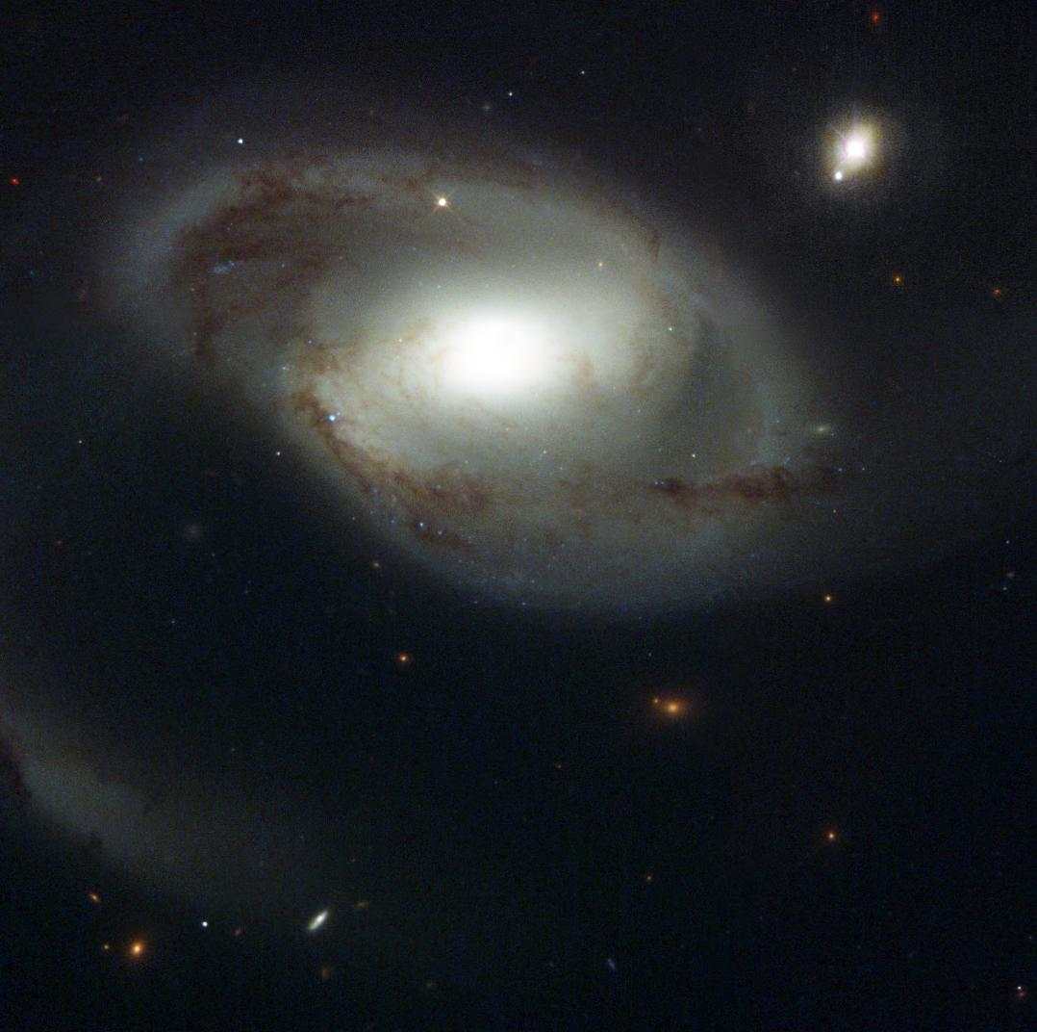
Does gas in the IGM care about galaxies?
Tracing the Circumgalactic Medium in Lyα with COS
David M. French
University of Wisconsin - Madison
Advisor: Bart Wakker
June 18, 2018
Image Credit: NASA and The Hubble Heritage Team (STScI/AURA)

Slide 2
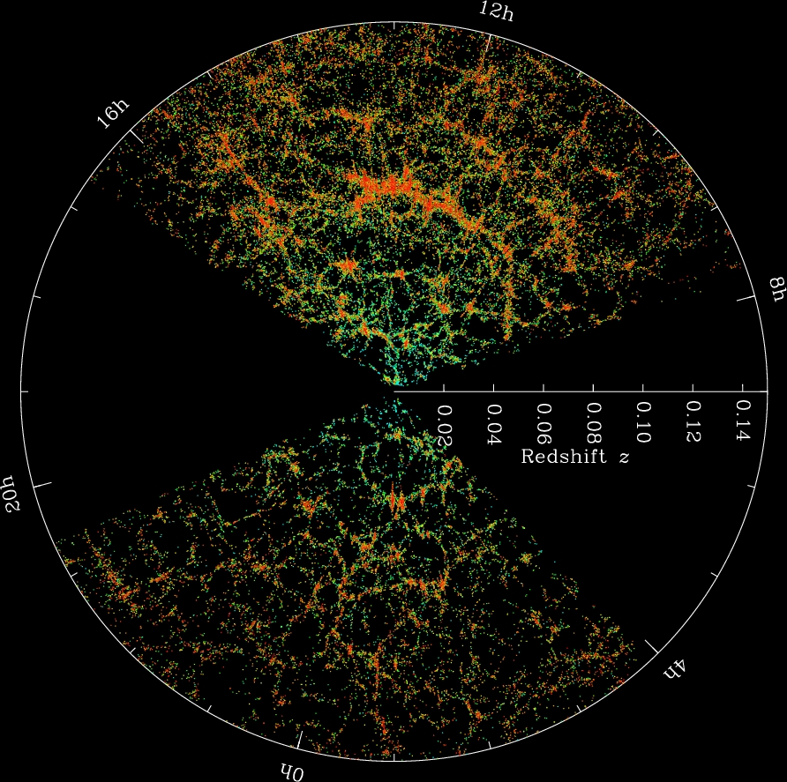
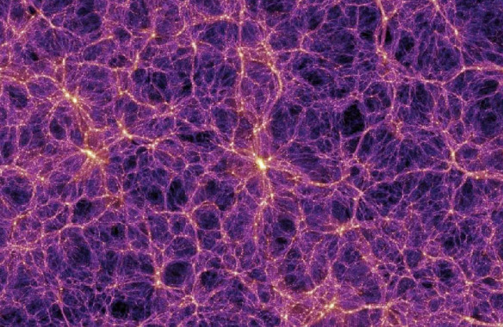
Gas + galaxies trace the same potential
The Millenium Simulation
SDSS Collaboration
Notes:
Gas collapsed with DM into filaments = cosmic web, formed galaxies

Slide 3
Does the gas care about the galaxies?
Gas and galaxies should follow the same DM potential
Galaxies need to continue accreting gas over cosmic time to match observations
Feedback kicks gas out of galaxies
How do the properties of halo gas correlate with nearby galaxy properties?

Slide 4
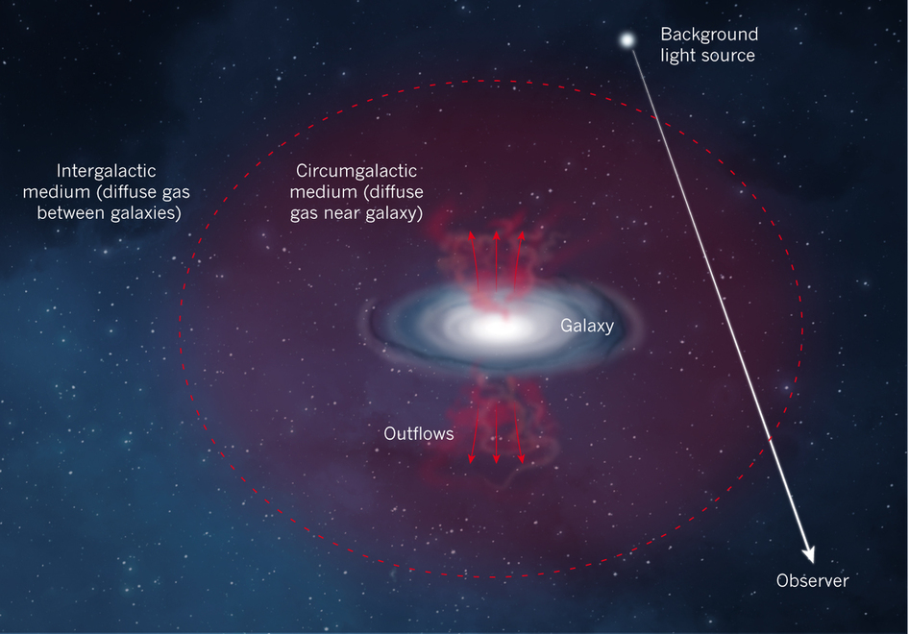
Probing the CGM with QSO absorption
Diffuse halo gas -> QSO absorption
Must rely on serendipitous QSO locations
Build a sample of single galaxy-QSO pairs
Impact parameter and ΔV give absorber position
ΔV
Impact parameter (ρ)
Nature 517, 444

Slide 5
Science Outline
Use archival COS sightlines (~700 total)
Catalog Ly-alpha lines
Correlate with galaxy environment
Limit search to cz < 10,000 km/s
Ask:
1. Ly-alpha EW – vs – galaxy proximity, size, orientation
2. Ly-alpha velocity – vs – galaxy rotation (co-rotation?)

Slide 6
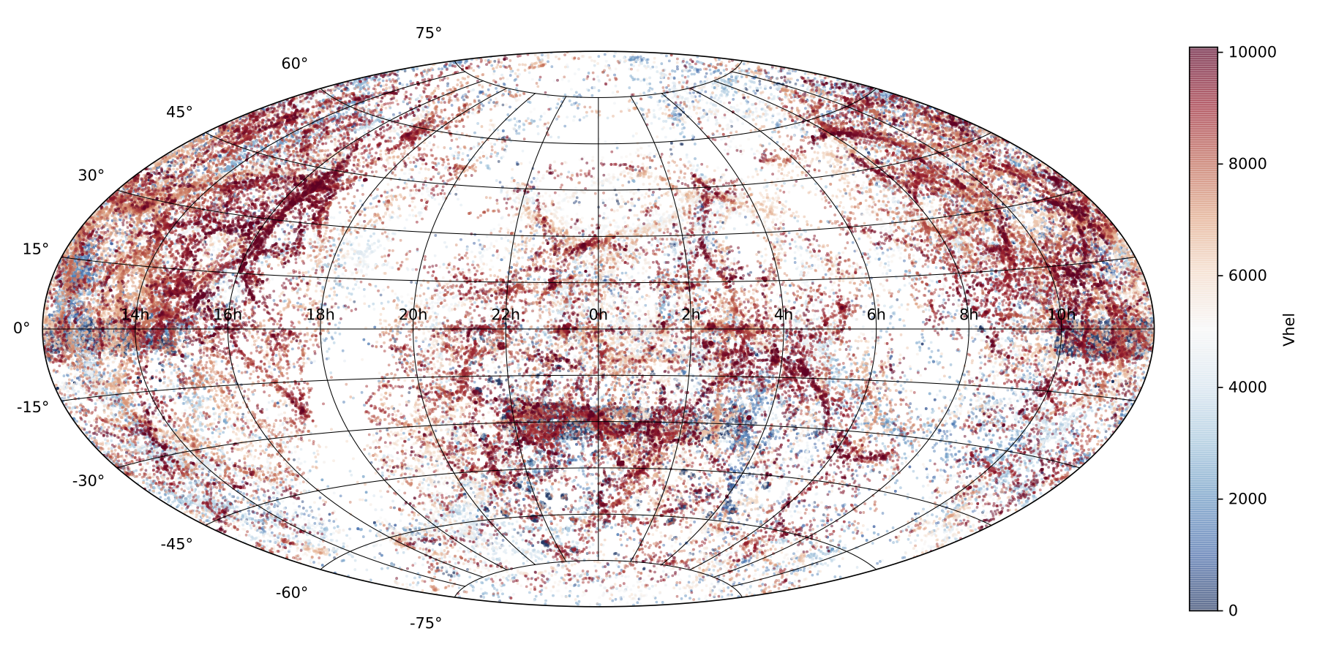
New Nearby Galaxy Catalog
Gather existing galaxy data
NED + IRSA
130,000+ galaxies with cz < 10,000 km/s
French & Wakker 2018, in prep

Slide 7
New Nearby Galaxy Catalog
Homogenize existing data
Normalize diameters, inclinations, PAs to 2MASS values
Choose representative magnitudes, calculate (L*, R_{vir})
French & Wakker 2018, in prep

Slide 8
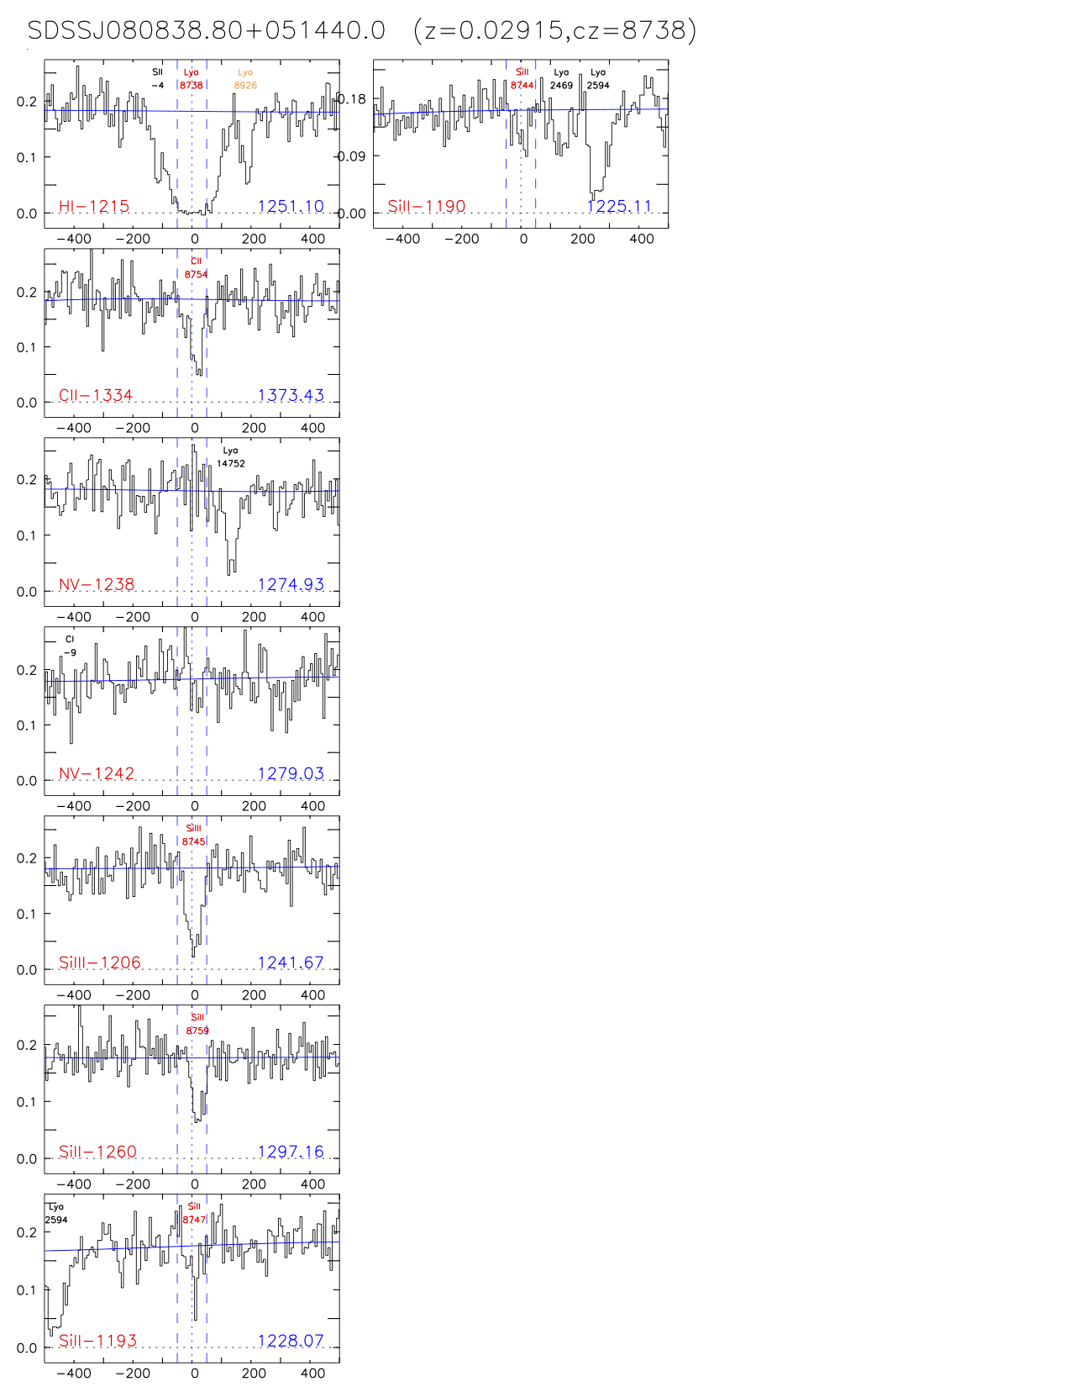
Catalog the absorbers
700+ G130M COS targets
Reduce, identify and measure all lines
Produce a catalog of fit parameters
French & Wakker 2018, in prep

Slide 9
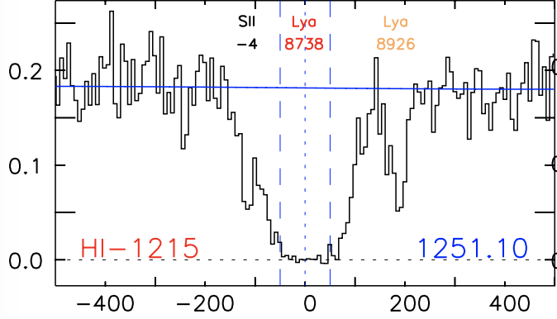
Catalog the absorbers
Concentrate on Ly-alpha
Correlate with galaxy environment
French & Wakker 2018, in prep

Slide 10
Catalog the absorbers
Connecting with galaxies – using our galaxy catalog
Which one?
French & Wakker 2018, in prep

Slide 11
Matching absorbers with galaxies
Define an objective “likelihood” parameter:
Define a likelihood:
= impact parameter
= viral radius of the galaxy
See French & Wakker 2017

Slide 12
Matching absorbers with galaxies
Applying the likelihood method
3D proximity indicator
Set criteria for ”association”
= 0.00027
= 0.16
French & Wakker 2018, in prep

Slide 13
Full (preliminary) Results
Status:
224 spectra reduced, identified AND measured:
1004 Ly-alpha absorbers
French & Wakker 2018, in prep

Slide 14
Full (preliminary) Results
Status:
224 spectra measured:
1004 Ly-alpha absorbers
481 isolated (>500 kpc)
French & Wakker 2018, in prep

Slide 15
Full (preliminary) Results
Status:
224 spectra measured:
1004 Ly-alpha absorbers
481 isolated (>500 kpc)
232 isolated (but within 500 kpc)
French & Wakker 2018, in prep
French & Wakker 2018, in prep

Slide 16
Full (preliminary) Results
Status:
224 spectra measured:
1004 Ly-alpha absorbers
481 isolated (>500 kpc)
232 isolated (but within 500 kpc)
55 associated with 1 isolated galaxy
French & Wakker 2018, in prep

Slide 17
Full (preliminary) Results
Status:
224 spectra measured:
1004 Ly-alpha absorbers
481 isolated (>500 kpc)
232 isolated (but within 500 kpc)
55 associated with 1 isolated galaxy
141 associated with 1 galaxy, others around
French & Wakker 2018, in prep

Slide 18
Full (preliminary) Results
Status:
224 spectra measured:
1004 Ly-alpha absorbers
481 isolated (>500 kpc)
232 isolated (but within 500 kpc)
55 associated with 1 isolated galaxy
141 associated with 1 galaxy, others around
51 associated with 2 galaxies
”associated” with a single galaxy using our likelihood method
French & Wakker 2018, in prep

Slide 19
Full (preliminary) Results
Status:
224 spectra measured:
1004 Ly-alpha absorbers
More galaxies nearby => higher EW
481 isolated (>500 kpc)
232 isolated (but within 500 kpc)
55 associated with 1 isolated galaxy
141 associated with 1 galaxy, others around
51 associated with 2 galaxies
”associated” with a single galaxy using our likelihood method
French & Wakker 2018, in prep

Slide 20
Azimuth Dependence
Associated absorbers are bimodally distributed
Absorbers near 2+ galaxies are NOT
French & Wakker 2018, in prep

Slide 21
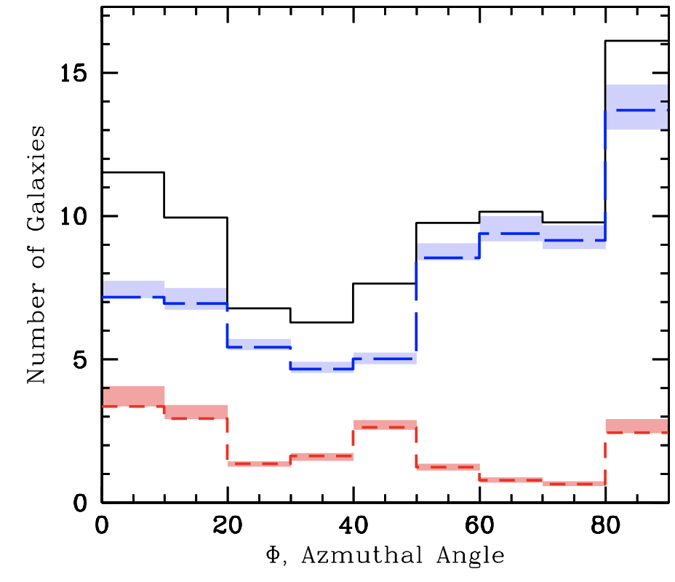
Azimuth Dependence
Similar to MgII azimuth dependence (Kacprzak+ 2012)
Shifted away from major/minor axis slightly?
Kacprzak+ 2012
French & Wakker 2018, in prep

Slide 22
Full (preliminary) Results
Status:
202 spectra reduced, identified, measured:
928 Ly-alpha absorbers
More galaxies nearby => higher EW
417 isolated (>500 kpc)
224 isolated (but within 500 kpc)
51 associated with 1 isolated galaxy
141 associated with 1 galaxy, others around
51 associated with 2 galaxies
”associated” with a single galaxy using our likelihood method
French & Wakker 2018, in prep

Slide 23
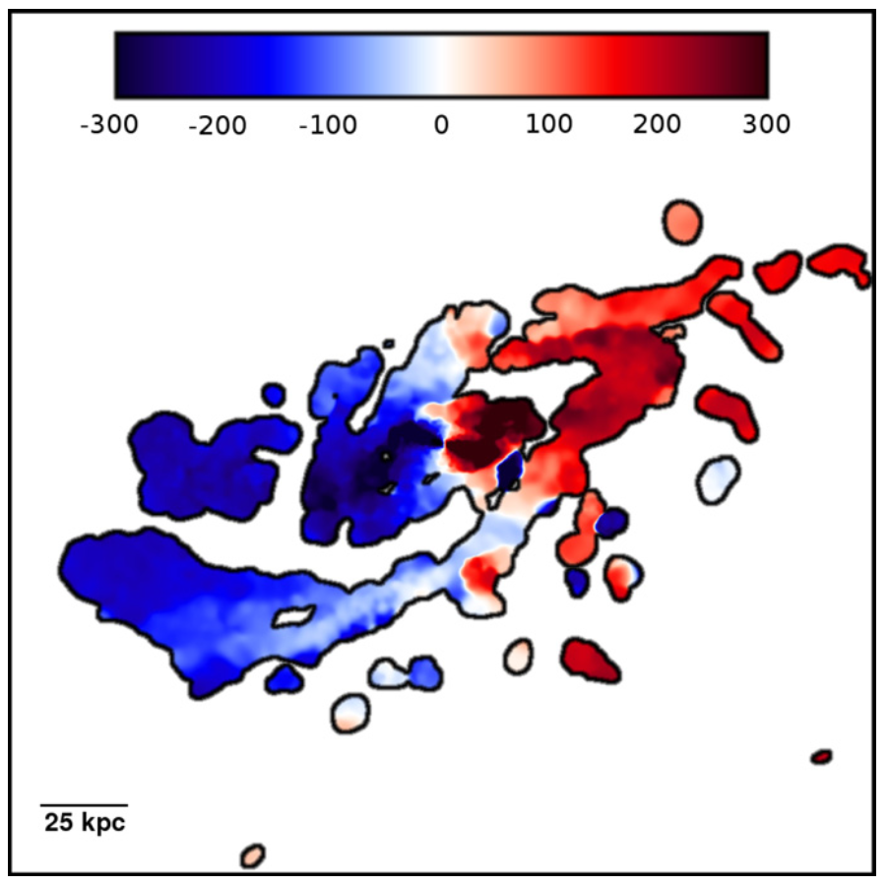
Do Ly-alpha absorbers care about
galaxy rotation?
Simulations suggest yes
(e.g., Stewart+ 2011)
Stewart+ 2011

Slide 24
Do Ly-alpha absorbers care about
galaxy rotation?
What does the sightline “see”?
Is there a halo – disk kinematic connection?
French & Wakker 2018, in prep
French & Wakker 2018, in prep

Slide 25
Model sightline velocity structure
What does the sightline “see”?
Is there a halo – disk kinematic connection?
French & Wakker 2018, in prep

Slide 26
Model sightline velocity structure
What does the sightline “see”?
New H-alpha rotation curves from SALT + additional from literature
French & Wakker 2018, in prep

Slide 27
Model sightline velocity structure
What does the sightline “see”?
New H-alpha rotation curves from SALT + additional from literature
Create mock rotating halo based on rotation curve – project onto sightline
French & Wakker 2018, in prep

Slide 28
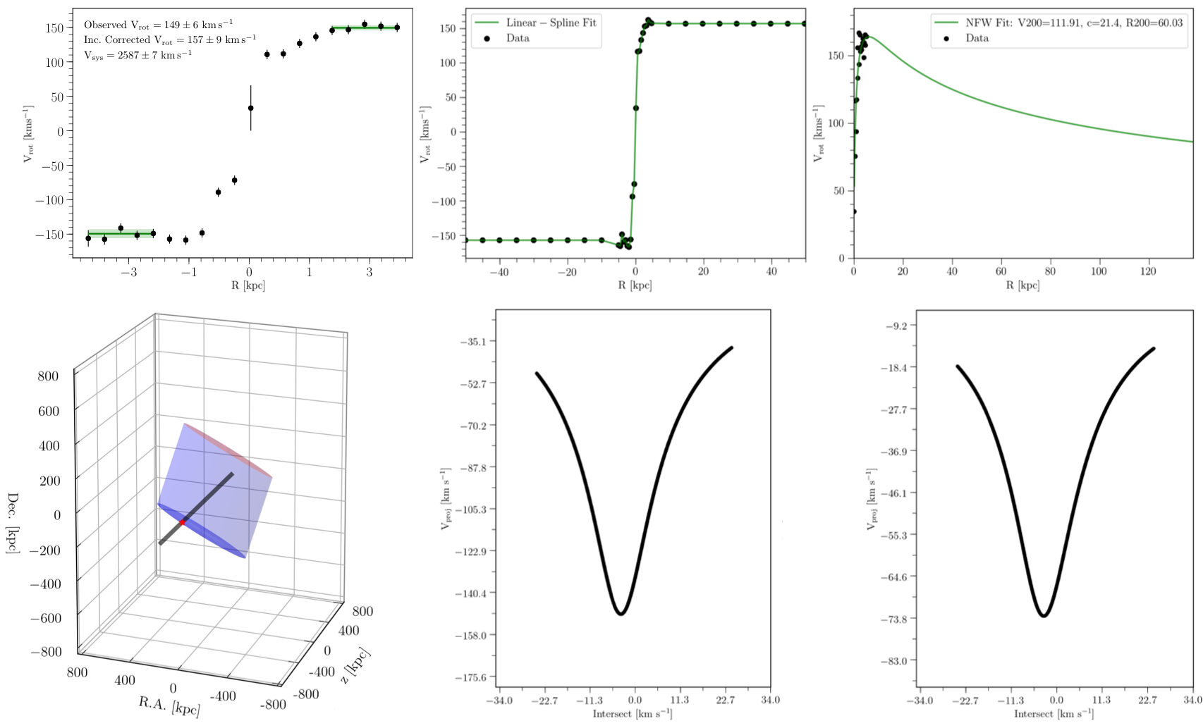
Model sightline velocity structure
What does the sightline “see”?

Slide 29
Model sightline velocity structure
What does the sightline “see”?

Slide 30
Ly-alpha co-rotation fraction
NFW halo model:
43% co-rotating

Slide 31
Ly-alpha co-rotation fraction
NFW halo model:
Only include Ly-alpha with Δv = +/- v_{rot}
63% co-rotating

Slide 32
Ly-alpha co-rotation fraction
NFW halo model:
Only include Ly-alpha with Δv = +/- v_{rot}
63% co-rotating

Slide 33
Ly-alpha co-rotation fraction
NFW halo model:
Only include Ly-alpha with Δv = +/- v_{rot}
Split around L*
1.5 L* and lower:
77% co-rotating

Slide 34
Ly-alpha co-rotation fraction
NFW halo model:
Only include Ly-alpha with Δv = +/- v_{rot}
Split around L*
0.5 L* and lower:
90% co-rotating

Slide 35
Ly-alpha co-rotation fraction
Co-rotation fraction smoothly decreases with increasing L*
Model independent

Slide 36
Model sightline velocity structure
NFW halo ->

Slide 37
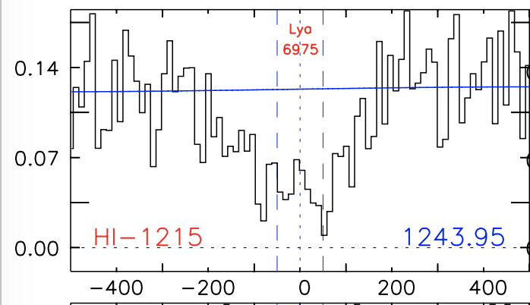
Model sightline velocity structure
What does the sightline “see”?
Compare to absorber velocity – is there a halo-disk kinematic connection?
CGCG039-137 : vhel = 6918 km/s
dv = 57 km/s
dv = 57 km/s
French & Wakker 2018, in prep
French & Wakker 2018, in prep

Slide 38
Model sightline velocity structure
What does the sightline “see”?
Compare to absorber velocity – is there a halo-disk kinematic connection?
CGCG039-137 : vhel = 6918 km/s
Preliminary!
dv = 57 km/s
dv = 57 km/s
French & Wakker 2018, in prep
French & Wakker 2018, in prep

Slide 39
Summary:
Correlating Ly-alpha from COS spectra with nearby galaxies
928 absorbers - using likelihood method to pair with the galaxy environment
Denser environment leads to higher EW Ly-alpha
Bimodal distribution around major and minor axes
Galaxy halo kinematics
Evidence for halo-disk kinematic connection?
Ly-alpha co-rotation fraction anti-correlates with galaxy L* and relative distance
Does CGM gas care about galaxies?
Yes!

Slide 40
Preliminary Results
EW vs impact parameter:
French & Wakker 2017
French & Wakker 2017

Slide 41
Preliminary Results
EW vs velocity separation:
Higher than galaxy
systemic velocity
Lower than galaxy
systemic velocity
French & Wakker 2017

Slide 42
Preliminary Results
Inclinations:
French & Wakker 2017
French & Wakker 2017

Slide 43
Inclination overabundance
Evidence of non-spherical halo?
Covering fraction of Ly-alpha < 1
Face-on
Highly-inclined
French & Wakker 2017

Slide 44
Summary:
700+ COS spectra correlated with 130,000+ galaxies
Expect ~3000 Ly-alpha absorbers
~1000 absorber-galaxy pairs using likelihood method
Strong EW – ΔV correlation
Overabundance around highly inclined galaxies
Model sightline velocity structure
Evidence for halo-disk kinematic connection?
Does CGM gas care about galaxies?
It seems like it might!
French & Wakker 2017

Slide 45
Model sightline velocity structure
What does the sightline “see”?
Is there a halo – disk kinematic connection?
CGCG039-137 : vhel = 6918 km/s
French & Wakker 2018, in prep
French & Wakker 2018, in prep

Slide 46
Model sightline velocity structure
What does the sightline “see”?
H-alpha rotation curves from SALT
French & Wakker 2018, in prep

Slide 47
Model sightline velocity structure
What does the sightline “see”?
Create mock rotating halo based on rotation curve – project onto sightline
CGCG039-137 : vhel = 6918 km/s
French & Wakker 2018, in prep
French & Wakker 2018, in prep

Slide 48
Model sightline velocity structure
What does the sightline “see”?
Compare to absorber velocity – is there a halo-disk kinematic connection?
CGCG039-137 : vhel = 6918 km/s
dv = 57 km/s
dv = 57 km/s
French & Wakker 2018, in prep
French & Wakker 2018, in prep

Slide 49
Model sightline velocity structure
What does the sightline “see”?
Compare to absorber velocity – is there a halo-disk kinematic connection?
CGCG039-137 : vhel = 6918 km/s
Preliminary!
dv = 57 km/s
dv = 57 km/s
French & Wakker 2018, in prep
French & Wakker 2018, in prep

Slide 50
New Nearby Galaxy Catalog
Homogenize existing data
Normalize diameters, inclination, PA to 2MASS values
Choose magnitudes, calculate (L*, R_{vir})
Magnitude – Diameter Relation
French & Wakker 2018, in prep

